Slide 1
Reliability Centered Maintenance
From a Data Center Perspective
March 2013

Slide 2
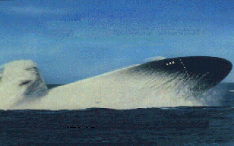

WHO AM I?
Roland M. Ignacio
Director Critical Systems
Power and Cooling

Slide 3
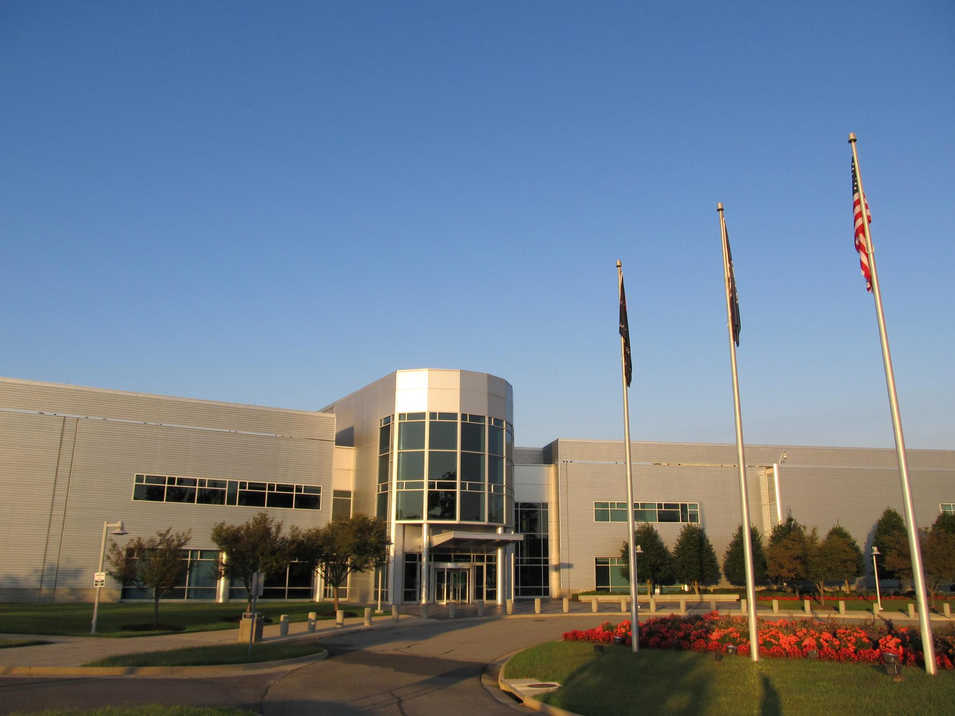
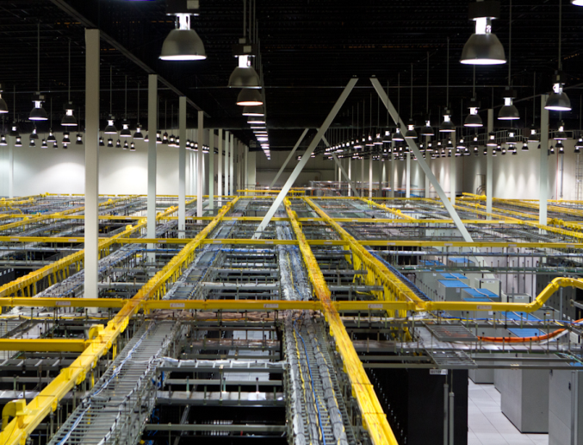
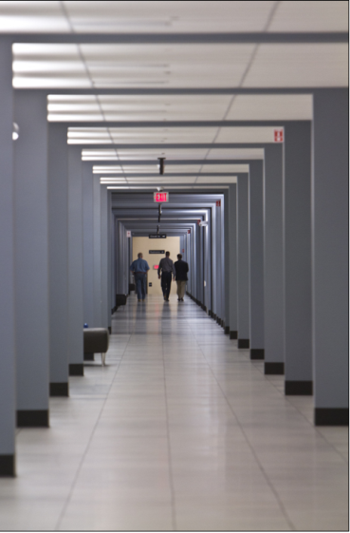
What is a Data Center?

Slide 4
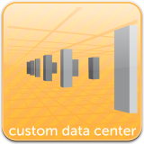
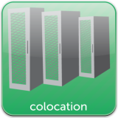

Who we are
Data Center within a Data Center
Large, private spaces - Scalable customized metered power
Reduced risk - greater flexibility
Faster deployments requiring less capital
Cabinets, Cages and Suites
  Configurable power options - Remote Hands & Eyes
  Stable, secure, fully monitored environment
  Ample expansion capacity
Highly Scalable, Virtualized Platform
Modular design enables rapid deployment and easily scales
Fully managed, fully monitored cloud-based service
Optimized utilization minimizes overall cost
Outsourced platform reduces capital requirements

Slide 5
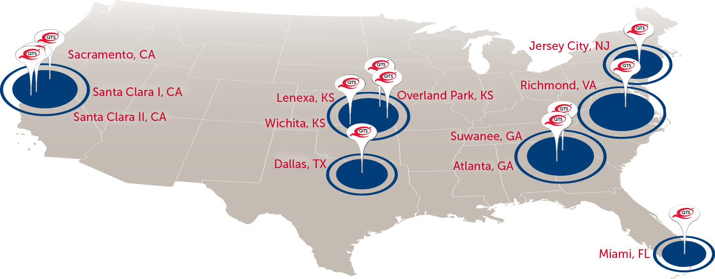

Slide 6
QTS METRO
A 990,000 Sq. Ft Facility!

Slide 7
QTS METRO
15,900 Tons of Cooling Capacity!

Slide 8
QTS METRO
120 MW of Utility Power

Slide 9
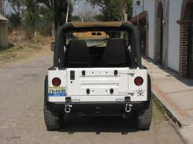
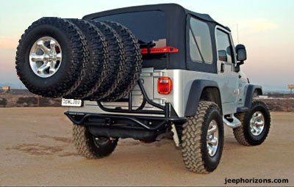
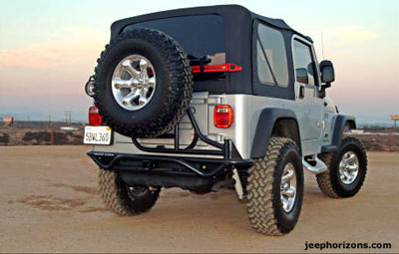
Redundancy
-From a tire perspective
N
2N
N+1

Slide 10
Goals of an Effective Maintenance Program
Ensure all infrastructure systems and Facility remains in a “like new” condition in order to provide high levels of up time and reduction of operational risk to clients occupying space.
Governance and CMMS are critical and are the single most essential components to achieving best in class as vetted by many industry maintenance consultants.
Maintenance equals cost avoidance, preservation of capital assets, energy efficiency and increases up time.
The goal is to achieve Reliability Centered Maintenance (RCM)
Notes:
Maintenance Governance:
In the case of business governance provides consistent management, cohesive policies, guidance, processes and decision-rights for a given area of responsibility. I believe to achieve the next level this is the basis for continuous improvement for QTS to demonstrate QTS cutting edge advanced capabilities and dedication to protect and preserve our customer business and QTS fiscal assets.
Select and Deploy CMMS:
Reliability Centered maintenance (RCM)
Failure analysis
Enhanced reporting
Parts and tool inventory control
Purchasing
Finance track maintenance labor and material cost
Deploy FAC Training Program:
TPC Technician Certification 4 levels
Liebert Factory Training
Monthly In-House Training system operation and MOP review (ongoing)
Key vendor lunch and learns
Energy and PUE
Drive PUE to meet business requirements
Controls Systems improvements for optimum energy and control
Push energy conservation plans for larger measurable results
National Agreements
Fire Alarm and Suppression Systems
Chiller Maintenance
Code required fuel tank testing
Roofing systems
Control Systems
Grounds and Landscaping
Waste and Recycling
Lighting Systems and Supplies
Consumable maintenance supplies i.e., belts, filters, lubricants
Continue Standardizing Operations:
Help drive sales through product knowledge “facility and systems “ training
Continuous review, process and policy enhancements
Drive Best Practice utilization from industry and internal development

Slide 11
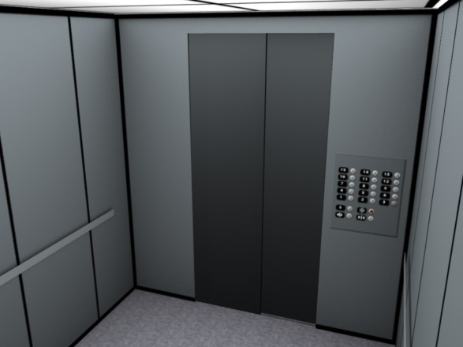
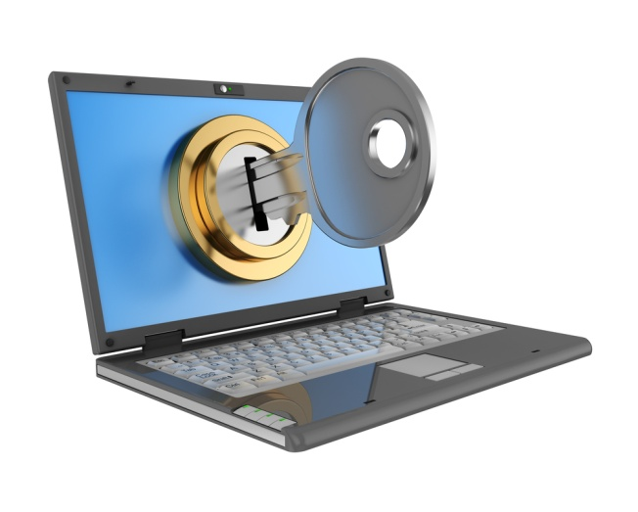

What is Reliability Centered Maintenance?
Reliability Centered Maintenance (RCM) is the end result of combining Predictive Maintenance and Traditional Maintenance Practices
RCM shall take Risk vs. Reward into consideration
  Safety – RCM shall not reduce the level of safety nor shall it override National, State or local requirements for Safety.
  Security – RCM shall not place any undue risk to the security of the facility or its clients
  Operations and Uptime – RCM shall not place the continued operations or uptime at risk

Slide 12
How do you determine RCM?
It is defined by the technical standard SAE JA1011 [3], Evaluation Criteria for RCM Processes, which sets out the minimum criteria that any process should meet before it can be called RCM. This starts with the 7 questions below, worked through in the order that they are listed:
1. What is the item supposed to do and its associated performance standards?
2. In what ways can it fail to provide the required functions?
3. What are the events that cause each failure?
4. What happens when each failure occurs?
5. In what way does each failure matter?
6. What systematic task can be performed proactively to prevent, or to diminish to a satisfactory degree, the consequences of the failure?
7. What must be done if a suitable preventive task cannot be found?

Slide 13
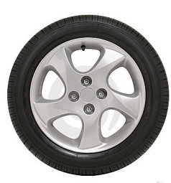
Lets look at this from a car tire perspective
1. What is the item supposed to do and its associated performance standards?
  Provide safe and efficient means to connect the car to the road
2. In what ways can it fail to provide the required functions?
  Flat, low pressure,
3. What are the events that cause each failure?
  Puncture, faulty valve, poor balance
4. What happens when each failure occurs?
  The tire must be serviced or replaced
5. In what way does each failure matter?
  It prevents the use of the car
6. What systematic task can be performed proactively to prevent, or to diminish to a
satisfactory degree, the consequences of the failure?
  Inspections, and rotations, replacement based on use or time or evaluated conditions.
7. What must be done if a suitable preventive task cannot be found?
  Purchase a higher quality tire, ensure redundancy or purchase reliability options

Slide 14
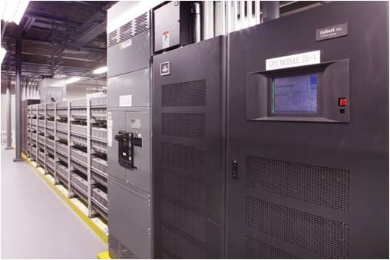
Governance Components
Established to ensure the entire team responsible for the operation and maintenance of facilities and infrastructure that support up-time goals in data centers has the resources, tools commitment and support from the Executive Committee to meet continuous availability goals.
Promotes consistent management, cohesive policies and top-down guidance as well all required standards, processes and decision-rights for Facilities/Maintenance Team areas of responsibility.

Slide 15
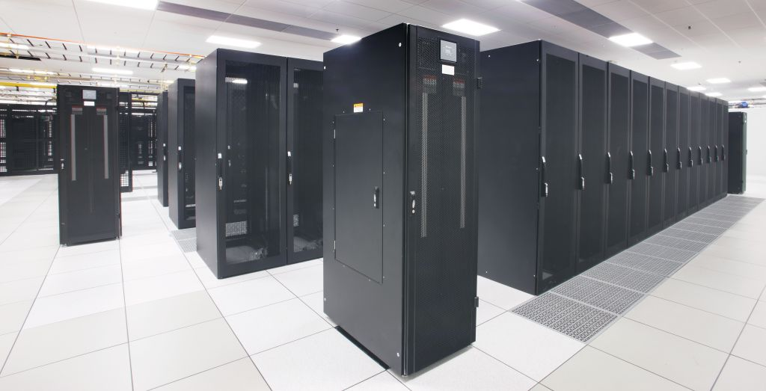
Governance Components (cont)
Encompasses the maintenance process it’s many components that are essential to the effectiveness and success of the maintenance program.
Outlines the resources, support and funding that are essential to reach the best in class level.

Slide 16
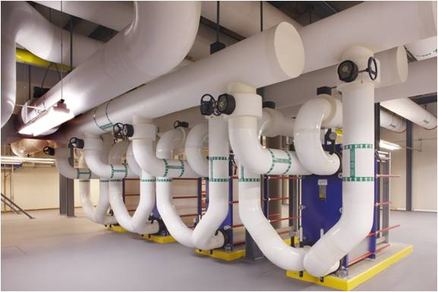
Governance Components (cont)
Outlines program components essential for success including a robust automated CMMS (Computerized Maintenance Management System) and all of its required components and functions.
Enables Sales and Marketing efforts to vocalize the success and effectiveness of maintenance practices, CMMS program and demonstrate reliability results.

Slide 17
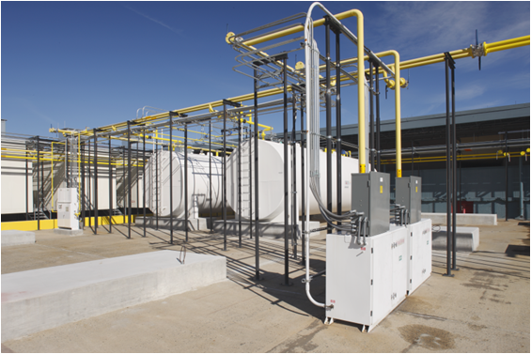
Governance Components (cont)
Instills owner and customer confidence in facilities and infrastructure as the choice locations to maintain business operations.
Finally and most importantly to achieve RCM (Reliability Centered Maintenance) maintenance practice’s RCM through operations and non-destructive analysis to increase maintenance effectiveness to reduce cost and risk.

Slide 18
Governance Organization
CEO
CTO
Exec VP Facilities
VP Facilities
VP Facilities
VP Facilities
Facility Director
Facility Director
Facility Director
Facility Director
Facility Director
Facility Director
Manager CAD Technical Library
Critical Systems Subject Matter Experts
Facilities

Slide 19
Review of the 7 steps to determining RCM
1. What is the item supposed to do and its associated performance standards?
  Provide safe and efficient means to connect the car to the road
2. In what ways can it fail to provide the required functions?
  Flat, low pressure,
3. What are the events that cause each failure?
  Puncture, faulty valve, poor balance
4. What happens when each failure occurs?
  The tire must be serviced or replaced
5. In what way does each failure matter?
  It prevents the use of the car
6. What systematic task can be performed proactively to prevent, or to diminish to a
satisfactory degree, the consequences of the failure?
  Inspections, and rotations, replacement based on use or time or evaluated conditions.
7. What must be done if a suitable preventive task cannot be found?
  Purchase a higher quality tire, ensure redundancy or purchase reliability options

Slide 20
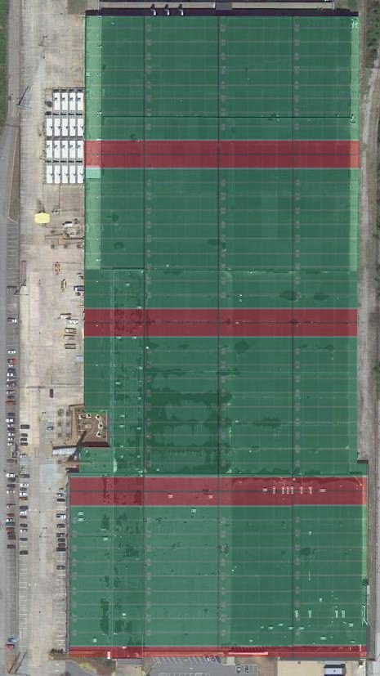
How many Football Fields?

Slide 21
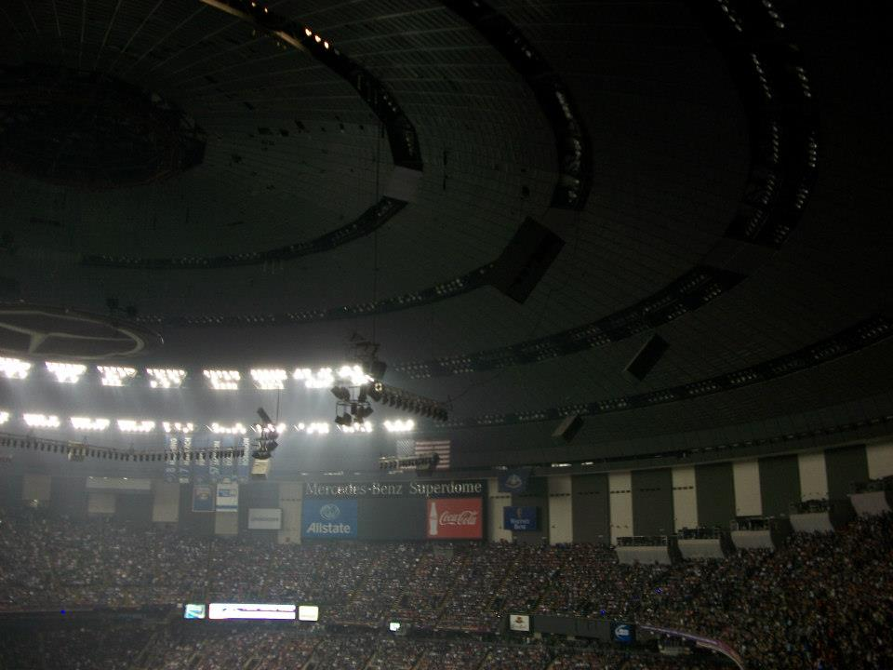

RISK vs. _ _ _ _ _ _

Slide 22
Thank you rignacio@qualitytech.com

