Slide 2
Leveraging the Evolving Workplace to Win
Michael Dziak, Chief Operating Officer e-Work.com, Inc
IFMA-Atlanta March 16, 2011

Slide 3
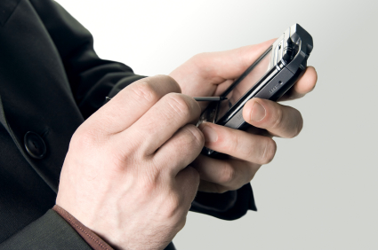
Today’s Topics
Realities of the New Workplace
What it Takes to “Evolve” the Workplace
Evolved Workplace Case Studies
Answer Your Questions
Resources and a Bonus

Slide 4
Teleworking Statistics
US teleworkers rose dramatically by 39% - from 12.4 million in 2006 to 17.2 million in 2008
2009 Telework Trendlines Survey 2009
40% of American workers could work from home
79% would choose to if the opportunity were given to them
Telework Research Network (TRN) Workshifting Benefits Study
Small business: 1997 - 9%; 2007- 19%; Now - 44%
2010 National Small Business Association survey

Slide 5
Telework is Becoming the Rule
Company | % Regular Telecommuters
Cisco Systems | 70%
eBay | 48%
Booz Allen Hamilton | 34%
S.C. Johnson & Son | 32%
American Fidelity Assurance | 30%
Shared Technologies | 26%
Principal Financial Group | 23%
Goldman Sachs | 22%
Yahoo | 20%
Qualcomm | 18%
FORTUNE Best Places to Work®
with programs:
1999: 18 Companies 2010: 83 Companies

Slide 6
More Than Just Telework
Mobility adoption curve Courtesy CoreNet Global
Percentage of Mobile Workers
Lifestyle
Programs
Real Estate Programs
Pilots
Added people and productivity values
Early
Adaptors
0%
1990
1995
2000
2005
2007
Future

Slide 7
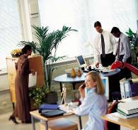
Realities of the New Workplace
Company Site
Company Sites
Home
Individual Workplaces
Enclosed office
Open work station
Dedicated
Free address
Quiet work space
“Focus” room
Touchdown
Team
Workplaces
One-to-one meeting room
Project rooms
Conference rooms
Open team areas
Community Places
Informal meeting areas
Cafeteria
Coffee points
Visitor entry
Virtual teams in multiple locations
Satellite Site
Source: CoreNet Global
Telework Center
Customer premises
Supplier premises
Hotel
Airport
Airplane
Bus
Car
Train
Other
On The Go
Enabled by mobile technologies that are
both place-centric (WLAN) and mobile (voice and data)

Slide 8
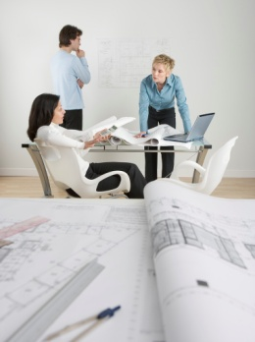
New Terminology
Distributed Workplace
Hoteling Workplace
Engaged Workers
Digitally Competent
Ambient Awareness
Weisure time
Relationship Accelerator
Collaboration Age

Slide 9
What it Takes to “Evolve” an Organization

Slide 10
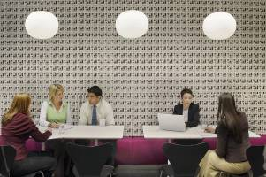
What it Takes to “Evolve” an Organization
Develop a new work dynamic
Facilitate of the transition
Work and manage smarter
Use technology as an intermediary
Make spaces for smarter working
Create structures to support freedom
Support the Smart Workforce

Slide 11
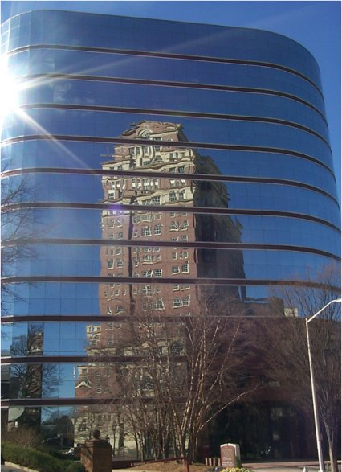
Key Features of the New Work Dynamic
Culture based on trust
Employees and managers all on the same side
Employees become self-motivated
Goal: Collaboration to happen naturally
Measure results not presence
Apply the process is with equality and consistency

Slide 12
Case #1
Automobile Maker:
New National HQ
Case #8
Telecommunications Services & Supplier:
Establish Mobile-Friendly Workspaces
Case #2
Insurance Company:
Hiring Home-Based CSRs
Case #7
Computer Equipment Manufacturer: New Flexible Organization
Case Studies
Case #3
Medical Technology Manufacturer:
Align Workspace with Job Function
Case #6
Telecom Equipment Manufacturer
Showcase Benefits of Mobility, Catalyst for Change
Case #4
Software Company:
Optimize Ability to Compete
Case #5
Metropolitan Area:
Expanding Regional Economic Development
Facilitating the Transition

Slide 13
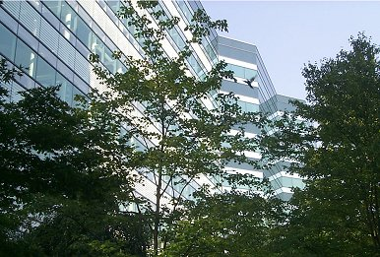
Case Study 1
Goal: Reduce real estate costs, improve productivity, maximize workplace efficiency
Circumstance: Occupy new headquarters building with less than 1:1 Ratio
Methodology: Required managers and directors to submit a plan for reduced occupancy.
Major Issues: Cultural incongruence, strong management resistance, starting program from scratch.
Solution: Resources put into project management, strong policy and procedures, opinion shift through manager training and workshop.
Measure of Success: Cultural shift, successful move, program participation growth
Automobile Manufacturer: Move to New National Headquarters
Back to Case Studies

Slide 14
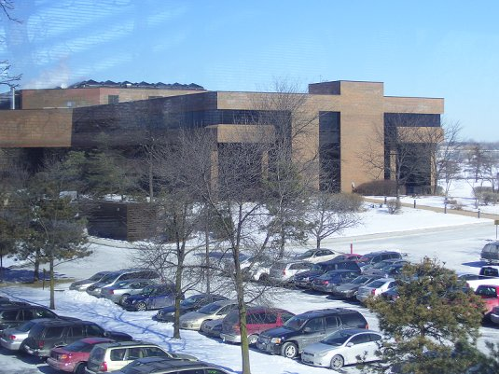
Case Study 2
Goal: Hire home-based CSRs
Circumstance: Quality labor pool within commuting distance shrinking
Methodology: Extend recruiting reach to neighboring counties and state.
Major Issues: Has a close-knit “family” atmosphere, some management resistance, technology portability issues.
Solution: High level project leadership, developed a strong business case and high level ‘vision of possibilities,’ developed a solid policy and procedures, participant preparation through training.
Measure of Success: Significant CSR performance increase, reviewing all jobs for portability, program ready when expansion is needed.
Global Insurance Company:
Hiring Home-Based CSRs
Back to Case Studies

Slide 15
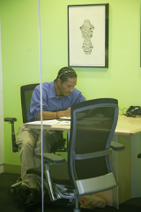
Case Study 3
Goal: Align work flexibility, technology and work spaces with job function, worker
Circumstance: Low workspace utilization, impact of commuting, changing world environment requires workforce readiness in the event of unexpected events
Methodology: Eight-stage change process, select, equip and prepare qualified participants, detailed planning process, developed ‘workstyle designations,’ group operating norms
Major Issues: Management resistance, selling leadership. organized process
Solution: Business case for executives, detailed program development process, managed change, pilot program
Measure of Success: Defined teleworker types, reinvented operating norms, improved asset utilization.
Global Medical Technology Supplier:
Align workplace with job functionality
Back to Case Studies
“Work is something you do, not a place to go”

Slide 16
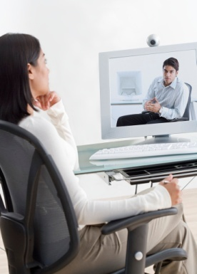
Case Study 4
Goal: Optimize ability to compete and innovate
Circumstance: Quality recruits expect distributed work opportunity
Methodology: Determine compatibility of employees’ current workstyle to distributed work, select, equip and prepare qualified workers to participate
Major Issues: Management resistance, leadership needed to be sold, lack of ‘burning platform’
Solution: Business case for executives, detailed participation process (application, tools, guidelines, protocols, technology, orientation, training, portal, videos, surveys)
Measure of Success: Positive feedback on communication, uptake slow, too early to show meaningful data
Global Software Supplier: Optimize Ability to Compete
Back to Case Studies

Slide 17
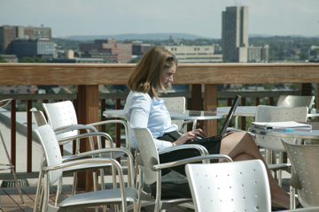
Case Study 5
Goal: Promote, educate and accelerate the adoption of telecommuting in the region, address skilled labor shortages
Circumstance: High demand for skilled labor, available talent limited
Methodology: Assemble a diverse team of decisionmakers in a common cause
Major Issues: Management resistance, leadership needed to be sold,
Solution: Draw community together with a common goal, identify key benefits, assist in program development and measurement ,
Measure of Success: After three years, 12 organizations in various stages of adoption, successful telework week, considerable interest by other employers
Metropolitan Area: Expanding Telework for Regional Economic Development
Back to Case Studies

Slide 18
Case Study 6
Goal: Showcase true benefits of mobility, ‘Walk the walk’ of their products, create employee flexibility, use building as catalyst for and symbol of change
Circumstance: Low workspace utilization, impact of commuting,
Methodology: workplace reinvention, research primary and secondary benefits
Major Issues: Some people still attached to their desks, management resistance, leadership needed to be sold
Solution: Business case for executives, best in class program, deep org. change
Measure of Success:
13% enhanced support of team performance
13% greater retention of staff
14% improved identify of the staff with brand
16% more fun place to work
19% increased attraction of talent
20% greater support of company culture & values
Global Telecom Equipment Manufacturer: Showcase True Benefits of Mobility

Slide 19
Case Study 6
Measure of Success:
6% less downtime
9% less noise
5% more face-to-face communication
8% improved meeting efficiency
7% enhanced innovation between teams
14% greater interaction between teams
14% increase in use of unplanned
meeting space
18% more available work space
22% increased pride in the image
of the work space
27% consistency of Brand image
Global Telecom Equipment Manufacturer: Showcase True Benefits of Mobility
Regional CEO:
“I don’t want an office, not even a desk.”

Slide 20
Case Study 6
Measure of Success:
1,360 people now work in space
designed for 950
1 person per 97 sq. ft. (9 sq. m.) vs. 199 sq. ft. (18.5 sq. m.) industry average
116% efficiency rating – people to desks
$4,850 cost per desk vs. $8,850 market average via Staubach data
$1.15 million per annum lease savings
$5.2 million savings on fit-out costs
25% decrease in energy & electricity use
267 vehicles in 196 spaces via stacked
valet parking
$298,000 decrease in net cost of
car-park operations
Global Telecom Equipment Manufacturer: Showcase True Benefits of Mobility
Back to Case Studies

Slide 21
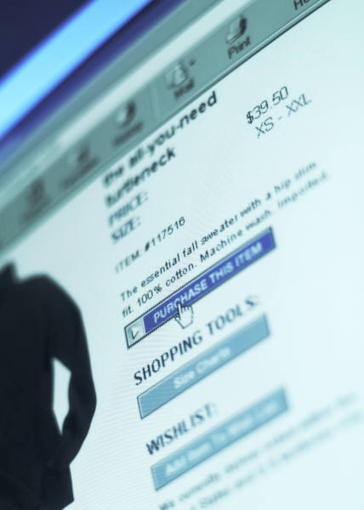
Case Study 7
Goal: Update organization with technology, efficiency in productivity and workplace
Circumstance: Low workspace utilization, impact of commuting, team selection dependent on geography
Methodology: Instill flexible workplace practices, enhance collaboration, reimburse employees for high speed internet and phone service in their homes
Major Issues: Management resistance, concern about lower performance
Solution: Best practices program development, large percentage of worker participation, use of thin client and flexible telephony system
Measure of Success: Saved $68 million/yr real state costs: 15,000 work from home 2 days per week,10 to 15 per cent more activity per employee per week and they were happier.
Global Computer Equipment Manf’r:
Flexible Organization
Back to Case Studies

Slide 22
Case Study 8
Goal: Develop flexible workspace for employees who primarily work from home
Circumstance: Need an atmosphere for teleworkers to optimize work efficiency and collaborate when in the office
Methodology: Take telecommuting to the next level
Major Issues: Resistance by new leadership, prepare large numbers of employees now
Solution: Provide a flexible workplace, provide a productive work location, touch screen concierge for reservations, open 24/7, provide transition training to users
Measure of Success:
Avoided 142 million commute miles per year, with annual fuel savings of approximately 7 million gallons and a net reduction of 61,637 metric tons of CO2-equivalents (CO2e) emissions per year.
At the end of 2009 more than 10,000 approved telecommuters and has expanded
Telecommunications Equipment/Service Provider: Mobile-Friendly Workspace

Slide 23
Case Study 8
Measure of Success (2000 study)
On average, $3,000 per teleworker is saved in real estate and related costs (e.g., energy)
Productivity of teleworking employees has increased from 15 to 20%, and the increases seem to be related to enhanced morale, fewer meetings and fewer interruptions
Reduced employee stress and improved morale
Since the program began, telework has grown to include 55% (or 36,000) of AT&T staff
87% of management telework an average of six days a month
Telecommunications Equipment/Service Provider: Mobile-Friendly Workspace
Back to Case Studies

Slide 24
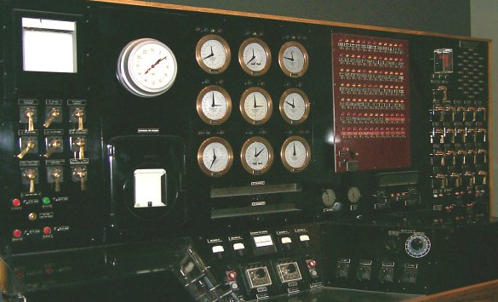
Leveraging the Evolving Workplace to Win

Slide 25
Facilitating the Transition
Start at the top
People have to understand it
People need to want it
Change must come from inside
Proper pace and effective coordination
Universal scope: Affects everyone
Topology of Work: Catalyst for Change
Plantronics

Slide 26
Questions

