Slide 1
Rob Langejans, Haworth
“Get Clear and Get Results”

Slide 2
Copyright Materials
This presentation is protected by US and International copyright laws.
Reproduction, distribution, display, and use of the presentation without written permission of the speaker is prohibited.
© 2014 Haworth, Inc. All rights reserved.
Notes:
As a registered provider of CEU programs Haworth is required to include this slide as part of the AIA continuing education requirements for 2006.
This presentation is available as a guide for you to prepare your own presentation.

Slide 3
"IFMA ATLANTA DISCLOSURE POLICY
IFMA Atlanta does not sponsor or endorse any product, instrument, device, service, or material discussed during the experience, event or program to be presented by the instructor. IFMA Atlanta will receive no compensation from any third-party enterprise related to the presentation whether public or private, operated for profit. IFMA Atlanta will disclose any instructor’s proprietary interest in any product, instrument, device, service, or material discussed during the presentation to be provided by the instructor.
Further, no IFMA Atlanta officer, director, or committee member in his or her official capacity is permitted to approve, sponsor, endorse, or do anything that may be deemed or construed to be an approval, sponsorship, or endorsement of any method or manner of handling, using, distributing, or dealing in any material or product. "
Notes:
As a registered provider of CEU programs Haworth is required to include this slide as part of the AIA continuing education requirements for 2006.
This presentation is available as a guide for you to prepare your own presentation.

Slide 4
Notes:
As a registered provider of CEU programs Haworth is required to include this slide as part of the AIA continuing education requirements for 2006.
This presentation is available as a guide for you to prepare your own presentation.

Slide 5
Notes:
As a registered provider of CEU programs Haworth is required to include this slide as part of the AIA continuing education requirements for 2006.
This presentation is available as a guide for you to prepare your own presentation.

Slide 6
“Get Clear and Get Results”
Learning Objectives
The learner will have an increased awareness of common barriers to
effective communication
The learner will be able to articulate what “The Expert’s Curse” means to our ability to communicate
The learner will be able to apply a simple technique to add clarity to conversations
The learner will practice the technique and be able to apply in real-world scenarios
Based on content from, “Let’s Get Real or Let’s Not Play” by Mahan Khalsa
Notes:
Increase awareness of common barriers to effective communication
Articulate what “The Expert’s Curse” means to our ability to communicate
Learn a simple technique to add clarity to conversations
Practice the technique for real-world application
The technique I’ll cover is from the book, “Let’s Get Real or Let’s Not Play” by Mahan Khalsa from FranklinCovey, Inc. Other elements of today’s program is influenced by “The Seven Habits of Highly Effective People” by Stephen Covey.

Slide 7
Word Association
Trust
I will give you a word
Write down 10 or more words that are definitions, synonyms, meanings, or associations of that word.
There is no right or wrong, good or bad. Go for quantity not quality.
You have 45 seconds.
Notes:
This activity takes 10 minutes.

Slide 8
Word Association
Facility
I will give you a word
Write down 10 or more words that are definitions, synonyms, meanings, or associations of that word.
There is no right or wrong, good or bad. Go for quantity not quality.
You have 45 seconds.
Notes:
This activity takes 10 minutes.

Slide 9
Word Association
I will give you a word
Write down 10 or more words that are definitions, synonyms, meanings, or associations of that word.
There is no right or wrong, good or bad. Go for quantity not quality.
You have 45 seconds.
Notes:
This activity takes 10 minutes.
Point of this activity is to show that we all have different “meanings” for the same words we use. We think we are communicating the picture in our mind but in reality the listener will have a different picture.

Slide 10
What’s going on?
Definitions are found in dictionaries
Meanings are found in people
Notes:
After the activity from the previous slide, participants find out that we rarely agree on the meaning of terms.

Slide 11
Search for Meaning Beyond Initial Statements
High Level
Abstractions
Complex Equivalency
Notes:
Words we use are sometimes high level abstractions with several complex equivalency meanings

Slide 12
^{Leadership}
^{Empowerment}
^{Vision Service}
^{Control}
^{Strategy}
Rewards
Honest
Systems
Character
Example
Notes:
For example, if I said, “lets talk about leadership today” several words and meanings could come to mind.

Slide 13
“The Expert’s Curse”
The more you know and understand, the more you think everyone else knows and understands the same.
Notes:
This is why the opening exercise is so profound. The more we use common words or terms the more we get comfortable with them.
Although we might use the same words comfortably, we may not mean the same thing.
Another way to look at this is “the curse of knowledge” which is reference in the Heath brothers book, Made to Stick. We can’t unlearn something and that makes it hard to see things from a view of no knowledge.

Slide 14
Sample Scenario
Your boss says:
“Last quarter you and your team exceeded budget and you’ll need to make it up before the end of the year. Get back to me with a plan for what you intend to do to take care of this issue.”
Notes:
No Guessing! Is the mantra that Mahan in his book teaches – let’s not guess about terms and the meaning of words, but instead ‘seek first to understand’ as Stephen Covey would say.
What are the words that are possible “miss matches”?

Slide 15
Sample Scenario
VP of HR asks you:
“I need your team to provide more guidance on how to use the common spaces on each floor”
Notes:
What are the words that are possible “miss matches”?

Slide 16
Sample Scenario
Your significant other says:
“Can you plan something special for our anniversary this year?”
Notes:
What are the words that are possible “miss matches”?

Slide 17
Clarify Technique
How to answer a question with a question:
Notes:
This is a simple formula to be less abrupt and more collaborative (seek first to understand) in how you ask a question when someone asks you a question first.

Slide 18
Clarify Technique
How to answer a question with a question:
Successfully Clarify Key Words or Phrases
Listen
Softening Statement
“Clarify”
Notes:
This is a simple formula to be less abrupt and more collaborative (seek first to understand) in how you ask a question when someone asks you a question first.

Slide 19
No Guessing!
VP of HR asks you:
“I need your team to provide more guidance on how to use the common spaces on each floor”
Notes:
What are the words that are possible “miss matches”? Could “guidance” mean signage or something else? If it is signage, what signs? “be quiet” or “please clean up after yourself” or “first come first served”??

Slide 20
Clarify - Example
Technique to CLARIFY:
(Softening Statement) “Ok, my team can help you with that.
(Clarify) Just so we are on the same page, when you say “guidance”, what does that mean to what you are trying to accomplish?”
Notes:
Here’s an example of what the technique sounds like -

Slide 21
Softening Statement Examples
Yes, I can. Could I ask you . . .
That’s a common request. Do you mind me asking. . .
We’ve helped other departments with ...
As you know, there are several options…
Let’s think about what that might look like…
I’d be happy to put some options together…
Notes:
Softening Statements can come in many forms – of course, you want to use whatever makes sense to the situation and is something you would really say. We want this to be ‘in your words’

Slide 22
Practice
In pairs
Practice the technique for “CLARIFY”
In your own words - sound natural
Note: this is NOT a role-play
Person 1: Read the statement
Person 2: Pick a word and CLARIFY
Notes:
Let’s try this and see if it works!

Slide 23
Clarify Practice Facilities in RED Designers in BLUE
A Manager:
“Can you visit my department meeting to talk about our emergency preparedness plans?”
You:
Softening Statement; Clarify
The Client:
“Our space needs to be more dynamic and open. Can you design this type of space?”
You:
Softening Statement; Clarify
Notes:
Any facility in any location is can be subjected to nature’s forces, technological failures, or man-made destruction, the handbook notes. Security programs enable you to prepare your company for worst-case scenarios. Your facility needs to be protected from any disastrous occurrence, whether it’s a fire or vandalism.

Slide 24
Clarify Practice Facilities in RED Designers in BLUE
The VP of Operations:
“Can you help me show that our efforts are green?”
You:
Softening Statement; Clarify
The Client:
“We’re really looking to you to add more collaborative areas to our department.”
You:
Softening Statement; Clarify

Slide 25
Clarify Practice Facilities in RED Designers in BLUE
A Manager:
“I’ve got additional headcount coming in to my department and I need some help getting more people into the same space. Can you put together a plan that shows the changes we need to make for this happen?”
You:
Softening Statement; Clarify
The Client:
“We need to rethink our traffic flow from the entrance to the primary space. Is this easy to fix?”
You:
Softening Statement; Clarify
Notes:
What are the words that are possible “miss matches”?

Slide 26
Clarify Practice Facilities in RED Designers in BLUE
Executive:
“Has our organization adequately prepared our facilities team to minimize data processing risks?”
You:
Softening Statement; Clarify
The Client:
“Can you design our atrium so that enough daylight comes through?”
You:
Softening Statement; Clarify

Slide 27
Clarify Practice Facilities in RED Designers in BLUE
Executive:
“What have you done to benchmark our facility operations against others?”
You:
Softening Statement; Clarify
The Client:
“We’re very concerned with density…is this something you can help us address?”
You:
Softening Statement; Clarify

Slide 28
Clarify Practice Facilities in RED Designers in BLUE
Finance:
“We’re really looking to you for ideas to reduce our overall costs”
You:
Softening Statement; Clarify
The Client:
“Can you design our space so that our managers have a little nicer offices but not so nice that it becomes a problem?”
You:
Softening Statement; Clarify

Slide 29
Clarify Practice Facilities in RED Designers in BLUE
Executive:
“This year we expect more from you and your team so be prepared to participate in our strategic planning process.”
You:
Softening Statement; Clarify
The Client:
“Do you have some ideas for how to address the different workstyles in each department?”
You:
Softening Statement; Clarify

Slide 30
Clarify Practice
Your coworker:
“Can you help me on this project?”
You:
Softening Statement; Clarify

Slide 31
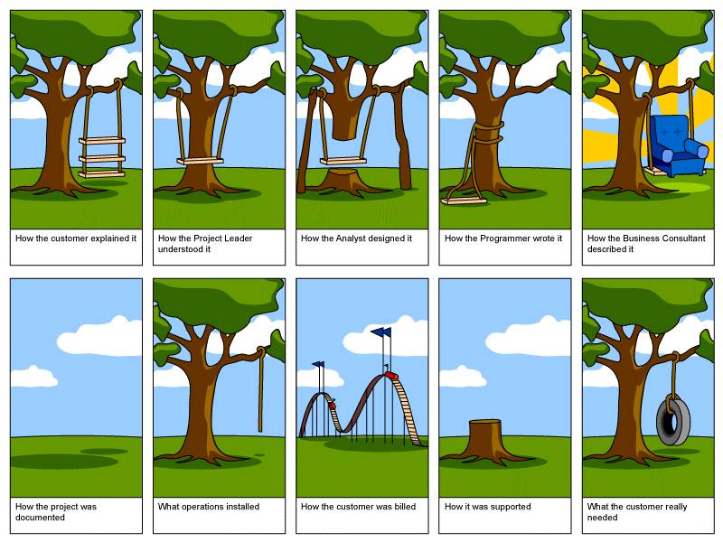
“What the department wanted”
What they had
How it performed
Their description of the fix
What we heard
What the design firm designed
The budget
The agreed upon solution
The expectations
What they got
What they really wanted
Notes:
Here’s a fun way to look at today’s topic…

Slide 32
Clarify
Notes:
In conclusion, even if you know HOW to clarify, it’s my concern that you won’t think you NEED to clarify. Did you really think you would get a match for the word “TRUST”? It’s even more common for us to think we have a match on words like “preparedness” and “safe” or even “quick turnaround”.
My challenge to you is this – in at least 2 conversations still today, pick one word and clarify it. See how it goes.
Remember – No Guessing!

Slide 33
Get Clear and Get Results
Learning Objectives Reviewed
What are some of the common barriers to effective communication?
Can someone from the audience articulate the “The Expert’s Curse”?
What does "the Expert's Curse" do to our ability to communicate
What is the simple technique that can be used to add clarity to conversations?
How did we practice this technique for real-world application?
Notes:
From Hayatt Whelihan
Learning Objectives Reviewed
> 1. What are some of the common barriers to effective communication?
> 2. Can someone from the audience articulate what “The Expert’s Curse” is?
> 3. What does "the Expert's Curse" do to our ability to communicate
> 4. What is the simple technique that can be used to add clarity to conversations?
> 5. HOw did we practice this technique for real-world application?

Slide 34
Get Clear and Get Results
Quiz Questions:
1. When communication breaks down it is commonly due to:
No one is listening
We have different meanings for the same words
Language barriers in our diverse world
Gender differences in how we hear and speak
2. Finish this sentence: “Definitions are found in dictionaries, _______ are found in people”
3. “The Expert’s Curse” means:
You make mistakes when you’re an expert
Experts have a hard time communicating
The more you know about a topic, the more you think everyone else knows the same
Even though you understand topics well, you have a hard time explaining them
4. To answer a question with a question, the formula includes a “__________ statement”
5. True or False: The word “Trust” means virtually the same thing to everyone
Notes:
Quiz Questions:
When communication breaks down it is commonly due to:
No one is listening
*We have different meanings for the same words
Language barriers in our diverse world
Gender differences in how we hear and speak
Finish this sentence: “Definitions are found in dictionaries, _______ are found in people” (Meanings)
“The Expert’s Curse” means:
You make mistakes when you’re an expert
Experts have a hard time communicating
*The more you know about a topic, the more you think everyone else knows the same
Even though you understand topics well, you have a hard time explaining them
To answer a question with a question, the formula includes a “__________ statement” (Softening)
True or False: The word “Trust” means virtually the same thing to everyone (False)

Slide 35
Thank you for your participation! We value your feedback. Please complete the survey.
“Get Clear and Get Results”
Before the Solution
Rob Langejans, Facilitator
Notes:
This slide unless there is an electronic survey later.

