Slide 1
Commercial Energy Efficiency Program
IFMA Luncheon
July 16, 2014
Notes:
Welcome to the Georgia Power Commercial Energy Efficiency Program training. This session is intended for contractors and service providers interested in participating in the Program and becoming registered Trade Allies. Customers and other program participants may find this training useful as an overview of the rebate requirements and application process.

Slide 2
Agenda
Program Overview
Eligible Equipment and Rebates
Online Application / Resources
Notes:
The training will include an overview of the program requirements, information on how to become a registered trade ally, a review of the eligible equipment and rebate levels, and finally a walk through of the online application process and resources available on the Georgia Power website

Slide 3
Program Overview
Benefits
Offsets the cost of energy efficient equipment and improves project payback for commercial customers
Delays new generation needs for Georgia Power Company
Must purchase new, efficient equipment and meet program guidelines
www.georgiapower.com/commercialsavings
Must be a Georgia Power Commercial customer
Industrial customers not eligible
Multifamily buildings with common areas (hallways, parking decks) may qualify
Notes:
These requirements apply to all participants in the Georgia Power Commercial Energy Efficiency Program. To be eligible, equipment must be new and meet all minimum efficiency and performance standards. We will explain what these standards are later in the training and you can always visit the program website link shown on this slide to review eligibility requirements.
For customers to receive commercial program rebates, they must be on a Georgia Power Commercial rate, and this includes all customers that are not on a residential or industrial rate. Exceptions can be granted for multi-family buildings on a residential rate. For these properties, common areas, including hallways and parking garages, may qualify for commercial rebates. Residential customers may also receive rebates through Georgia Power’s residential energy efficiency programs
To confirm a customer’s rate and verify they are commercial, review page 2 of their monthly electric bill and the word Commercial should be included in the Current Electric Service field.
And finally rebate applications must be submitted within 90 days of project completion or invoice date. This rule applies to all program participants. For example, if a lighting project was completed on June 1st, the deadline for submitting an application will be August 31st

Slide 4
Application Requirements
Applications can be submitted by customer contact or contractor/service provider
2014 projects must be submitted within 90 days of project completion or invoice date
Application submitted online - www.georgiapower.com/commercialsavings
Upload required documentation:
1) Equipment spec sheets
2) W9 for entity receiving the rebate
3) Project invoice
Notes:
*Emphasize that if projects are ongoing, be sure to track inventory of equipment installed and keep track of invoices for eligible equipment

Slide 5
Trade Ally Program
Promote the Commercial Energy Efficiency Program
Know how to verify customer and equipment eligibility
Assist customers with rebate applications
Provide required documentation in a timely manner
Notes:
Trade Allies are a big part of our energy savings strategy. You work with potential customers every day and can incorporate the rebate program into your service and product offerings. Ultimately these rebates can help customers upgrade and install more efficient equipment while spending less than they normally would. As a Trade Ally your role is to promote the program, know the application process, and be able to assist customers with basic equipment and eligibility questions, all of which we discuss during this training session. We could not reach our energy savings goal without you.

Slide 6
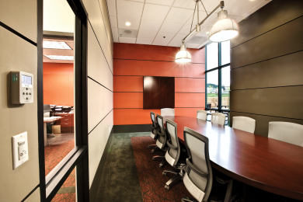
Eligible Equipment
Lighting
Heating & Cooling
Water Heating & Water
Reflective Roofing
Food Service & Grocery
Small Commercial
Custom Savings
Notes:
For those of you not familiar with the program and those of you in need of a refresher, we’ll spend the remaining 10 or 15 minutes going over what equipment is eligible for a rebate.
Put simply these things fall into 5 categories:
Lighting (this includes occupancy sensors)
Phase-out of many inefficient “legacy” products - T12 fluorescents, many PAR & BR lamps
New products flooding the market (e.g. LEDs) - Product quality issues and new standards and Costs continue to drop for some products
New technologies give us more options for “deeper retrofits
Heating & Cooling (includes HVAC retrofits and duct sealing)
Water Heater
Reflective Roofing
Food Service & Grocery

Slide 7
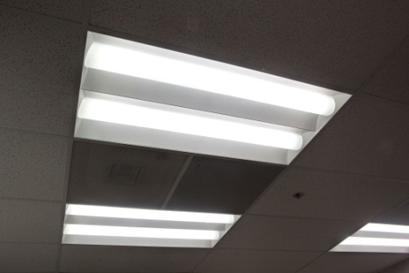
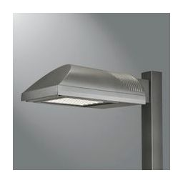
Lighting Rebates – Retrofit Projects
Interior and canopy lighting*: $0.20/watt reduced capped at $25,000 per building per year
Fixture upgrades and lamp/ballast retrofits
Outdoor pole-mounted lighting*: $0.20/watt reduced capped at $10,000 per building per year
Retrofit and metered systems only
Incentive payments must go directly to customer
1,000 watt MH → 400 watt LED. Rebate = $136
*up to 50% of project cost
Notes:
T12 to T8 – average about 50-70 watts, so $10-14 per fixture depending on the wattage reduction and whether you use reduced wattage T8s

Slide 8
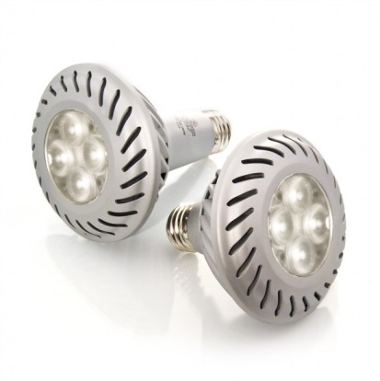
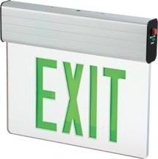
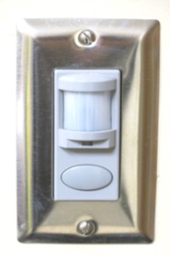
Other Lighting Rebates
LED Replacement Lamps: Up to $9/lamp for retrofit projects
LEDs replacing incandescent/halogen only (must be DLC, Energy Star, or LDL)
LED Exit Signs: Up to $7/sign for retrofit projects
CFLs: Hardwired up to $6.50/fixture and screw-in up to $1.25/lamp
Lighting Controls: Occupancy sensors up to $7/sensor and Daylight sensors up to $25/sensor
*Incentive will be paid up to 50% of the equipment cost (not to exceed rebate level) and capped at $25,000 per building per year

Slide 9
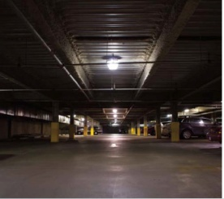
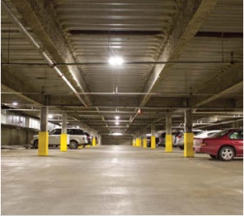
Sample Parking Deck Project
Parking garage retrofit: Metal halide to LED
Removed (450) 175 Watt Metal Halide
Total input watts per fixture = 205
Installed (450) 60 Watt LED fixtures
Total input watts per fixture = 60 (savings = 145 watts)
Georgia Power rebate: $13,050
Simple Payback
After Rebate: 2 YRS
Notes:
Rebate = $25 per fixture....highlight the cost benefit but don’t go into all the #s

Slide 10
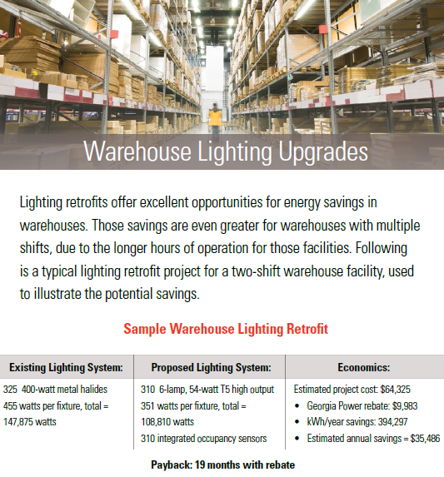
Sample Warehouse Project
Notes:
Rebate = $25 per fixture....highlight the cost benefit but don’t go into all the #s

Slide 11
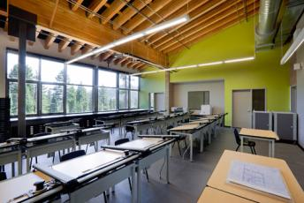
Lighting Rebates – New Construction/Major Renovation
New Construction / Major Renovations:
Lighting power density (LPD) requirement is 10% below ASHRAE 90.1-2007
$0.20/watt reduced below code
COMcheck / LPD Calculations
Capped at $25,000 per building per year
Also eligible for occupancy sensor and d daylight sensor rebates

Slide 12
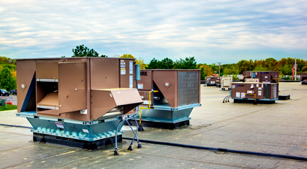
Heating & Cooling Rebates
HVAC Variable Frequency Drives (VFDs): $50/horsepower
New construction is not eligible
Must be installed on existing HVAC systems without VFDs
Air-cooled AC units, air-to-air unitary heat pumps, and water-source heat pump
AC unit: Tier 1 - $20/ton & Tier 2 - $30/ton
Heat pump: Tier 1 - $40/ton & Tier 2 - $60/ton
Water-source heat pump: $50/ton
Other high-efficiency HVAC equipment: Custom Savings
Notes:
Now lets get into HVAC
We’ve added Variable Frequency Drives to the program rebated at $50/horsepower controlled – this is only for HVAC related applications such as building exhaust fans, return air fans, cooling tower fans, chilled and condenser water pumps etc.
We’ve also changed the rebates for AC only and heat pumps. Now we have tiers to recognize different levels of efficiency – Tier 1 AC only units receive $20/ton and Tier 2 $30/ton
Tier 1 Heat pumps are $40/ton and tier 2 $60/ton, and water source heat pumps are $50/ton
If you want to apply for a chiller system or variable refrigerant flow system you will do that through our custom savings program which (Denise) will cover
Mention that the PDFs will be updated with the EER, SEER and IEER efficiency ratings.
For Custom Savings projects, they will need to set up a meeting with our technical team to discuss eligibility (Dean Jurecic will be main contact)

Slide 13
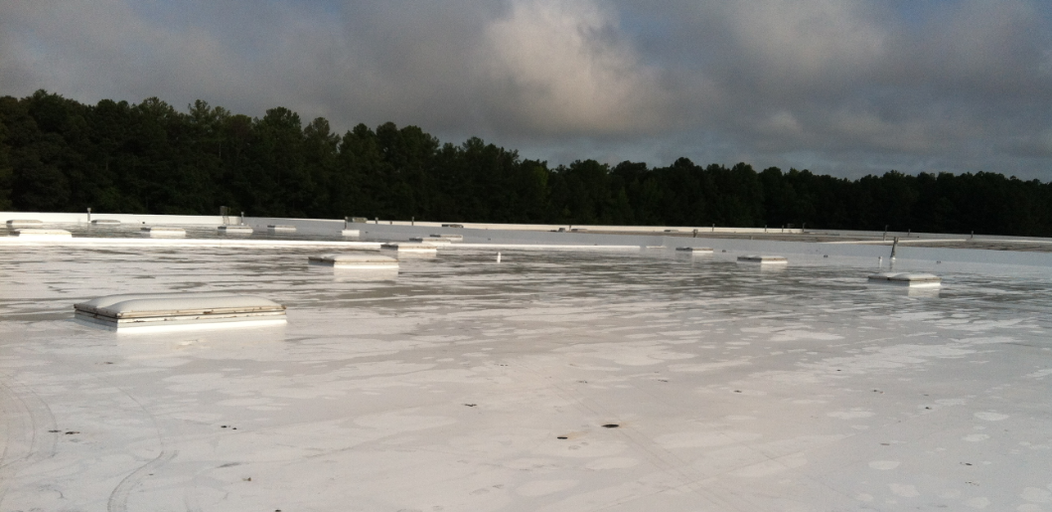
Reflective Roofing Rebate
Reflective Roofing
ENERGY STAR Qualified
Available for existing and new construction buildings
Roof over conditioned space only
$0.05/sq ft of applicable roof area (capped at $10,000)
Notes:
Now lets get into HVAC
We’ve added Variable Frequency Drives to the program rebated at $50/horsepower controlled – this is only for HVAC related applications such as building exhaust fans, return air fans, cooling tower fans, chilled and condenser water pumps etc.
We’ve also changed the rebates for AC only and heat pumps. Now we have tiers to recognize different levels of efficiency – Tier 1 AC only units receive $20/ton and Tier 2 $30/ton
Tier 1 Heat pumps are $40/ton and tier 2 $60/ton, and water source heat pumps are $50/ton
If you want to apply for a chiller system or variable refrigerant flow system you will do that through our custom savings program which (Denise) will cover
Mention that the PDFs will be updated with the EER, SEER and IEER efficiency ratings.
For Custom Savings projects, they will need to set up a meeting with our technical team to discuss eligibility (Dean Jurecic will be main contact)

Slide 14
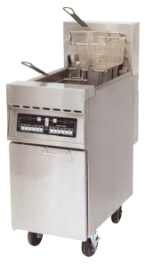
Food Service & Grocery Rebates
Food Service Equipment
Commercial & Low Temperature Dishwashers
Commercial Ice Machines
Commercial Glass-, Mixed-, or Solid-Door Refrigerators & Freezers
Electric Fryers, Griddles, Steam Cookers
Insulated Holding Cabinet
Must be ENERGY STAR Qualified
Grocery and Other Equipment
Grocery Anti-Sweat Control
Grocery Case Door Gaskets
Grocery Display Case LED Lighting
Refrigerated Vending Machine Control
Additional Food Service & Grocery Rebates Available - http://www.georgiapower.com/energy-efficiency/business/equipment.cshtml
Notes:
Now lets get into HVAC
We’ve added Variable Frequency Drives to the program rebated at $50/horsepower controlled – this is only for HVAC related applications such as building exhaust fans, return air fans, cooling tower fans, chilled and condenser water pumps etc.
We’ve also changed the rebates for AC only and heat pumps. Now we have tiers to recognize different levels of efficiency – Tier 1 AC only units receive $20/ton and Tier 2 $30/ton
Tier 1 Heat pumps are $40/ton and tier 2 $60/ton, and water source heat pumps are $50/ton
If you want to apply for a chiller system or variable refrigerant flow system you will do that through our custom savings program which (Denise) will cover
Mention that the PDFs will be updated with the EER, SEER and IEER efficiency ratings.
For Custom Savings projects, they will need to set up a meeting with our technical team to discuss eligibility (Dean Jurecic will be main contact)

Slide 15
Custom Savings: Overview
Incentive:
$0.08 / kWh – up to 50% of project cost / capped at $25,000 per year
Site-specific measures not included in lighting or other equipment rebates ($/unit)
New equipment installation only
Examples: Energy management systems, chillers, motors, demand control ventilation
Not available for changes in behavior or O&M strategies
Pre-approval required:
Application and engineering analysis must be submitted in advance of purchase/install
Notes:
In addition to equipment and lighting rebates, Georgia Power Commercial customers that install energy-saving technology are eligible for energy efficiency incentives based on calculated energy savings and permanent demand reduction
Demand ventilation controls and refrigeration system upgrades are other examples
Equipment must exceed efficiency levels required by local, state, or federal codes and standards
Examples include: Energy management systems, Chillers, HVAC system improvement, Motors

Slide 16
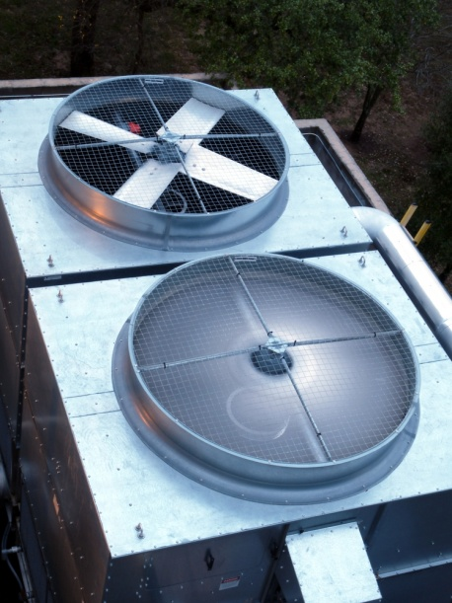
Custom Savings – Application
Custom Savings application must include:
Baseline Energy Consumption
Proposed Energy Consumption
Proposed Costs
Baseline and proposed system descriptions and documentations
Written proposal from Service Provider
Energy Models or Calculation Sheets (Trace, eQuest, etc)
If a spreadsheet is used, send an “active” copy with formulas
Include equipment, labor, and material costs as applicable
16

Slide 17
Small Commercial Program
PLS, GS, OGS, FLAT-GS, TOU-EO Commercial Customers ONLY
Existing Buildings only; must be on an eligible Small Commercial Rate
Similar to Residential Rebates
Programmable Thermostats
Ceiling Insulation
ENERGY STAR Appliances (refrigerator, freezer, clothes washer, room A/C)
Higher Lighting Incentives
$0.40/watt reduced for HID, fluorescent and LED fixture retrofits
Same $/unit incentives for LED screw-in lamps, LED exit signs, or CFL lamps
Eligible for all other equipment rebates: HVAC, Reflective Roofing, etc.
www.georgiapower.com/smallcommercial

Slide 18
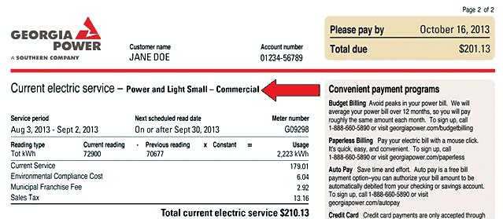
Who is Small Commercial?
Five rate classes are eligible
PLS (Power & Light - Small) -- TOU-EO (Time of Use Energy Only)
Flat-GS (Flat General Service) -- GS (General Service)
OGS (Optional General Service)
Notes:
Can call ICF rep or call center # on the website to confirm rate type is eligible

Slide 19
2014 Rebate Cap Review
¹ Up to 50% of project cost
² Up to 50% of equipment cost
Project Type | Incentive Rate | Cap per building per year
New/Existing Building Lighting | $0.20/watt reduced ¹ | $25,000
Prescriptive Lighting (LED lamp; LED exit; CFLs; and Sensors) | $/unit ² | $25,000
Outdoor Pole-Mounted Lighting | $0.20/watt reduced ¹ | $10,000
Custom Savings | $0.08/kWh ¹ | $25,000
Reflective Roofing | $0.05/sq. ft. | $10,000
Notes:
Unless capped, the rebate

Slide 20
Energy Efficiency Program: Online Resources
Resources:
Rebate Application Link
PDF’s of eligible equipment
Trade Ally Program Information
Trade Ally Network “Locate a Contractor”
www.georgiapower.com/commercialsavings

Slide 21
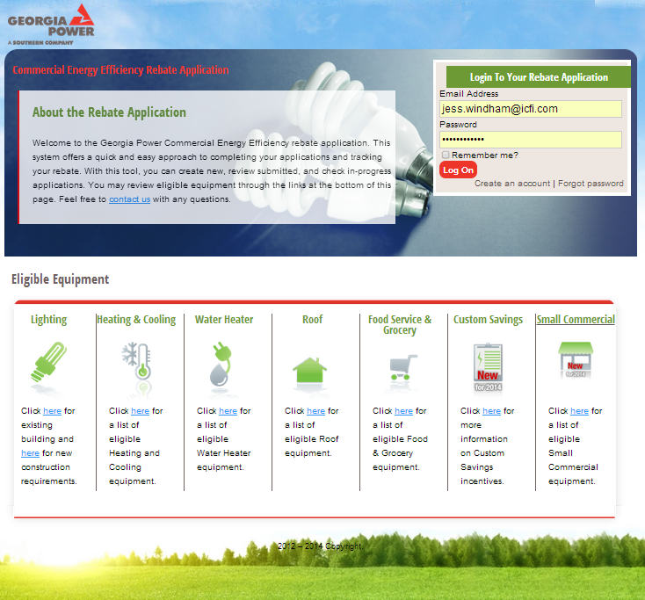
Energy Efficiency Rebate Application
Rebate Application Link:
Create a Login (new account)
PDF’s of eligible equipment per project type

Slide 22
Energy Efficiency Rebate Application
Rebate Applications:
New Applications
In Progress
Rebate Estimates
Submitted

Slide 23
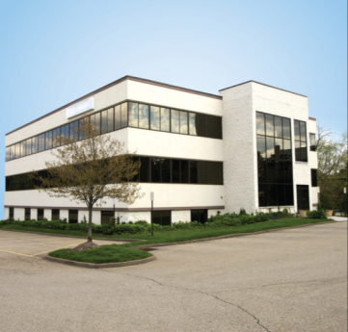
Things to Keep in Mind…
Confirm eligibility with ICF before placing orders or starting work (especially for LEDs, HVAC, and Custom Savings projects)
Document scope of work changes and submit to ICF for review and approval
Keep track of invoices for eligible equipment purchases
Notes:
Mention common contractor approach – 1st question is are you a GA Power commercial customer?
Industrial / Manufactures / NonGPC commercial are not eligible

Slide 24
Program Contact
www.georgiapower.com/commercialsavings
Commercial Energy Efficiency Program
Alexis Goldman – Alexis.Goldman@icfi.com / 404.929.8361
We look forward to helping you access available rebates and implement your energy efficiency projects!

